Slide 1

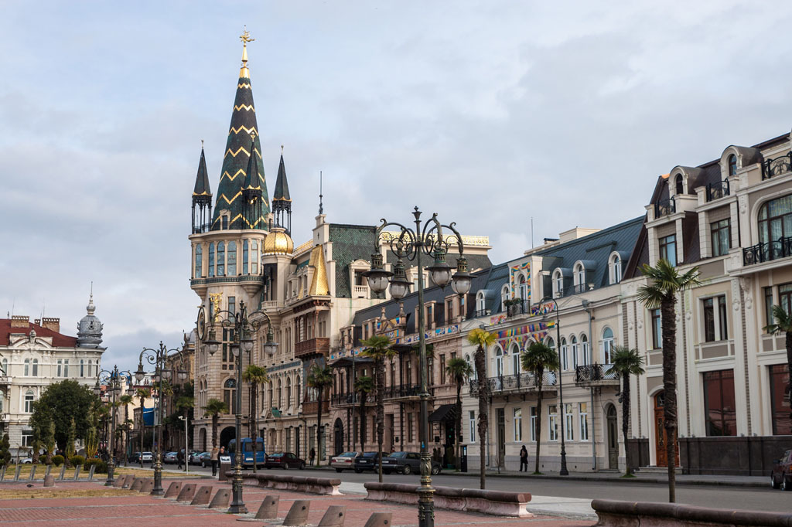
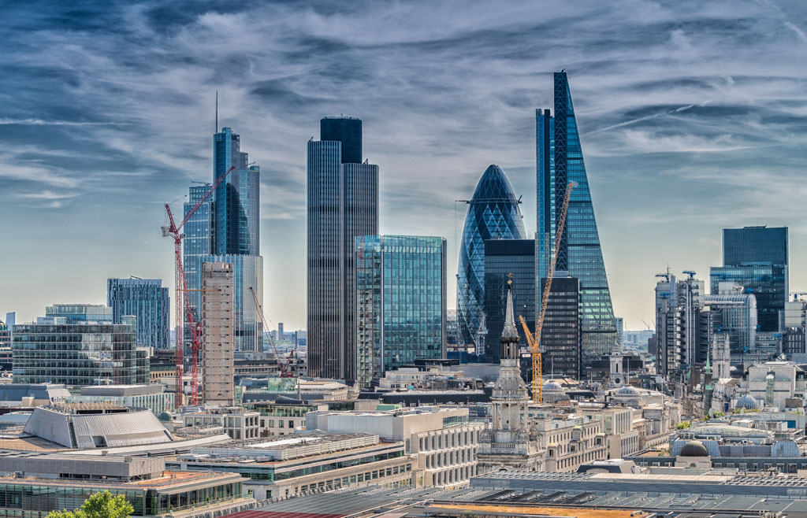
-2022 SPRING-
Enlightenment of people’s voice:
Research on the current outbreak of COVID-19 in Shanghai based on public opinion analysis
人民之声的启示——基于舆情分析的上海2022年春季新冠疫情研究
Group members:
黄芷仪 邵雨辰 师昱昊 田野佑民

Slide 2
C
ONTENT
True mastery of any skill takes a lifetime. Sweat is the lubricant of success, speak louder than words.
01
Introduction
引言
02
Data acquisition and preprocessing
数据采集与预处理
03
High-frequency words analysis and visualization
高频词语分析与可视化
04
Sentiment analysis and visualization
情感感知分析与可视化
05
The cognition of public opinion from the perspective of urban planning
城市规划视角下对舆情的认知
06
Conclusion
结语

Slide 3
01
Introduction
引言
01
1.1 Research background 研究背景
1.2 Research status 研究现状
1.3 Research framework 研究框架

Slide 4
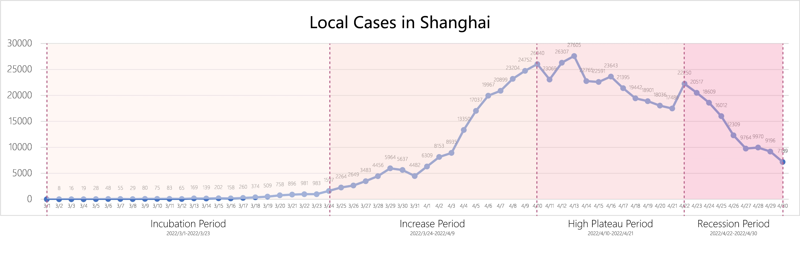
1.1 Research background 研究背景
Chronological division of the epidemic phase
The epidemic of COVID-19 process is complex, and user opinion varies greatly at different stages. Based on the changes in the scale of the number of confirmed cases, combined with the significant events of the epidemic, this paper divides the whole process of the development of the new crown epidemic into four stages: Incubation period, Increase Period, High Plateau Period, Recession Period.

Slide 5
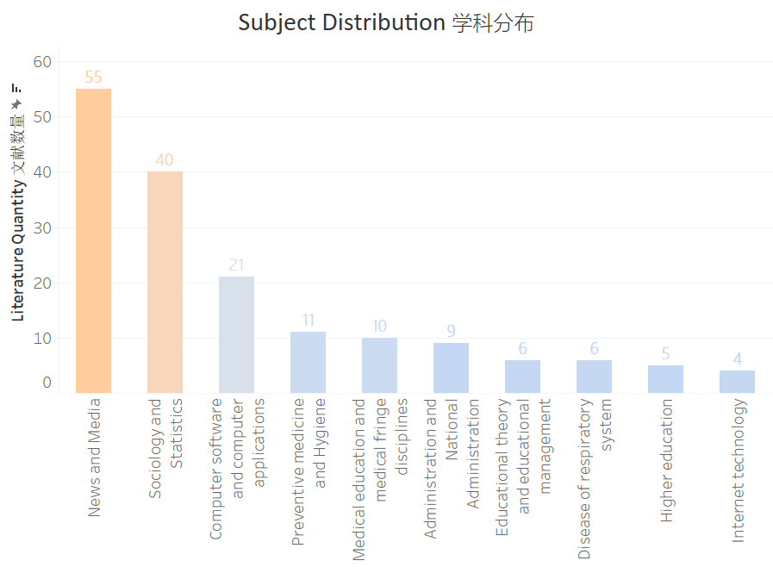
1.2 Research status 研究现状
Current situation of public opinion analysis on the epidemic situation in China:
我国关于疫情相关舆情分析的研究现状：
104 articles on CNKI (all Chinese)
Two categories:
Research on the social impact of public opinion
Text research technology
中国知网共收录104 篇研究文献（皆为中文）
两种类型
舆情的社会影响研究
文本研究技术

Slide 6
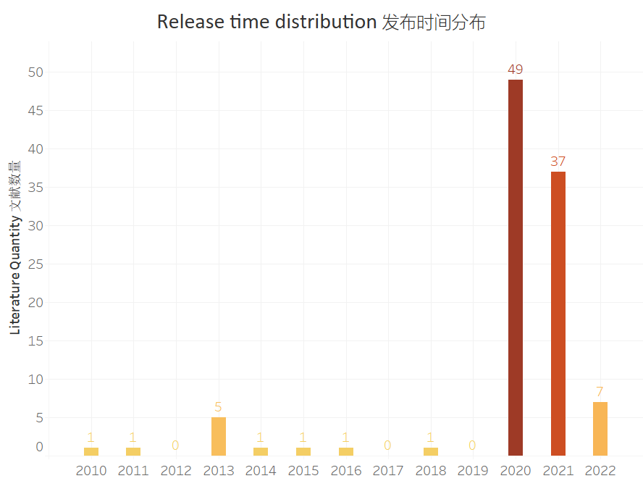
1.2 Research status 研究现状
Current situation of public opinion analysis on the epidemic situation in China:
我国关于疫情相关舆情分析的研究现状：
Research on public opinion about the epidemic began in 2010, but a large number of studies focused on 2020 and beyond.
This mainly depends on two factors: network development and the outbreak of the epidemic.
关于疫情舆情的研究始于2010年，但大量的研究集中在2020年及之后出现。这取决于两个因素：网络发展与疫情的发生。

Slide 7
1.3 Research framework 研究框架
Data Acquisition
数据采集
Weibo post acquisition
微博博文采集
Epidemic data collection
疫情数据采集
Data Pre-processing
数据预处理
Dataclean
数据清洗
Word segmentation optimization
分词优化
DeleteStops
去停用词
Epidemic stage classification
疫情阶段划分
Combing through the timeline
时间线整理
Word frequency count
TF-IDF词频计算
Data Analysis and Visualization
数据分析与可视化
Hotspot analysis
热点分析
Co-occurrence analysis
共现分析
Sentiment analysis
情感分析
Word cloud rendering
词云绘制
Construction of coword network
共词网络构建
Sentiment classification
SnowNLP情感分类
Epidemic data visualization
疫情数据可视化
Space-time-evolution of hot topics
热点话题时空演化
Cluster analysis
聚类分析
Events correlation analysis
事件关联分析
Analysis and thinking of urban planning
城市规划角度的分析与思考
News content and microblog data comparison
新闻与微博博文数据对比
Public feedback on epidemic prevention policies
防疫政策的公众反馈
Strategies from the perspective of urban planning and enlightenment
城市规划角度的策略与启示

Slide 8
1.3 Research framework 研究框架
数据采集
微博博文采集
疫情数据采集
数据预处理
数据清洗
分词优化
去停用词
疫情阶段划分
时间线整理
TF-IDF词频计算
数据分析与可视化
热点分析
共现分析
情感分析
疫情数据可视化
词云绘制
共词网络构建
SnowNLP
情感分类
热点话题时空演化
聚类分析
事件关联分析
规划角度的分析与思考
新闻与微博博文数据对比
防疫政策的公众反馈
城市规划角度的策略启发

Slide 9
02
Data acquisition and pre-processing
数据采集与预处理
02
2.1 Data acquisition 数据采集
2.2 Data pre-processing 数据预处理

Slide 10
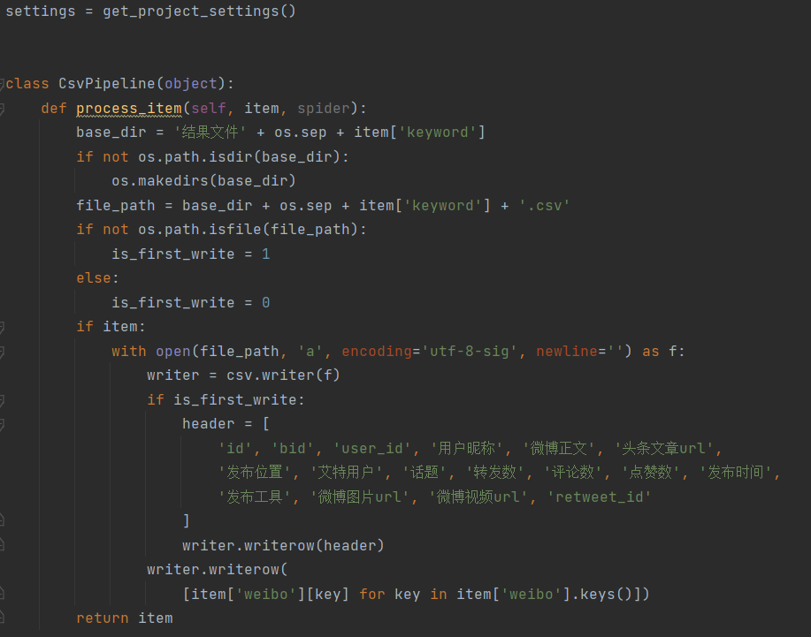
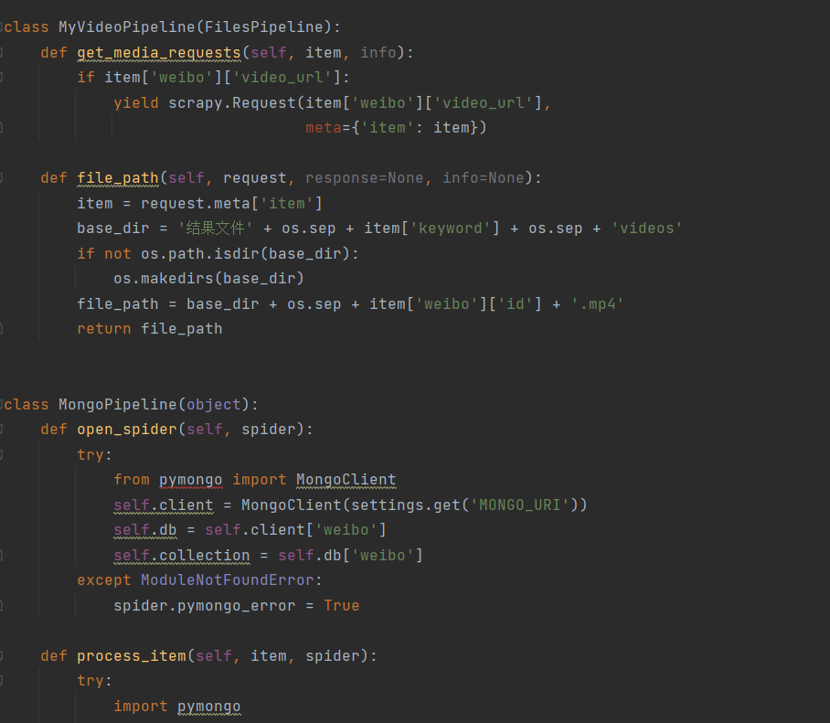
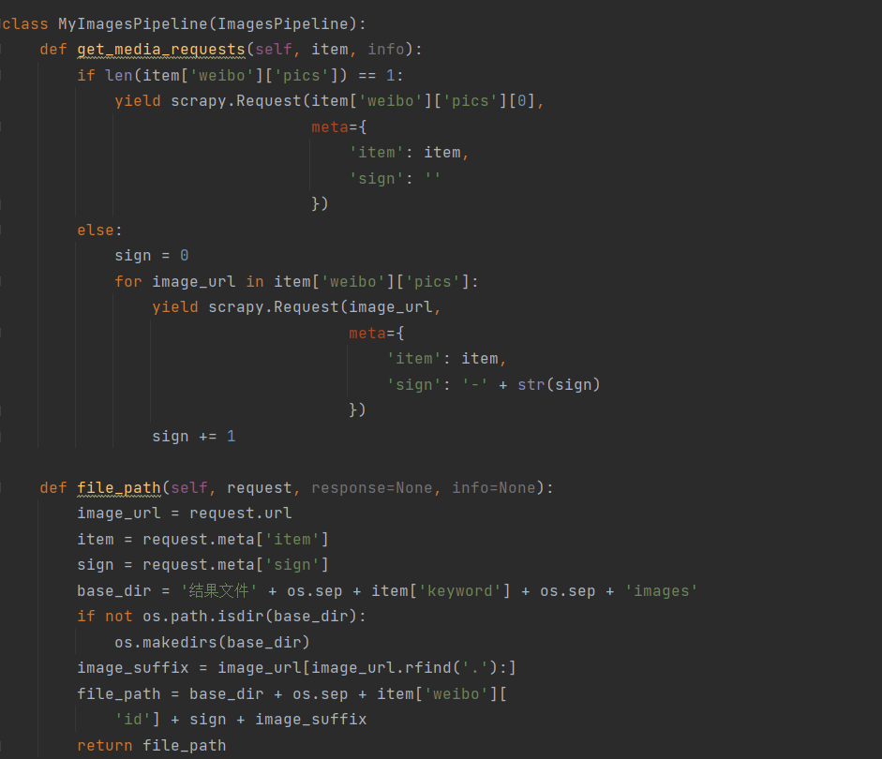
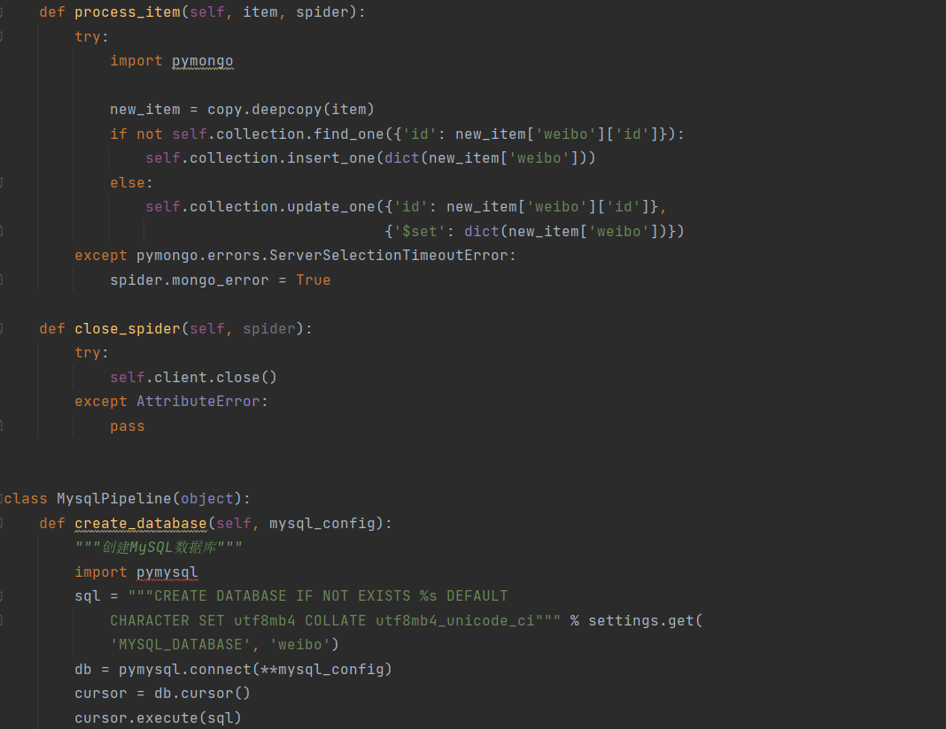
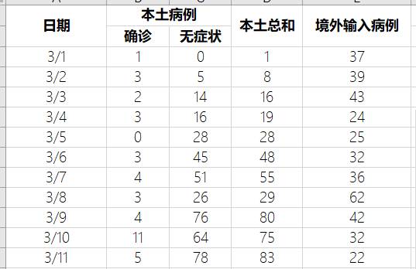
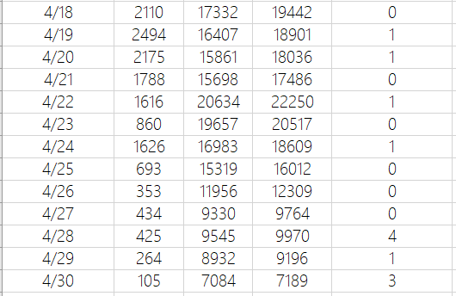
2.1 Data acquisition 数据采集
For the epidemic data:
Data source: https://wsjkw.sh.gov.cn/
Data acquisition way: https://github.com/bai-yu-lan/sh-covid19
For the people opinion data:
Data source: Sina Weibo
Data acquisition way: Use python to crawl data
疫情数据采集:
数据来源： https://wsjkw.sh.gov.cn/（上海卫健委官网）
数据采集方式：https://github.com/bai-yu-lan/sh-covid19
舆情数据采集：
数据来源：新浪微博
数据采集方式：Python爬取
Code snippet 代码片段
Epidemic data section 疫情数据节选

Slide 11
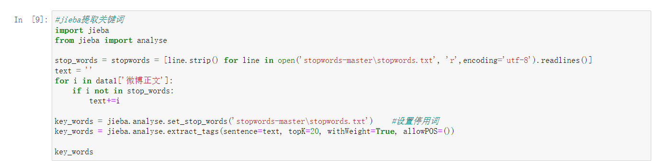
2.2 Data pre-processing 数据预处理
In this step, we cleaned 90932 pieces of data and deleted useless information. We will be released after cleaning data according to the post on geographical position, found only 9864 blog publishing location is in Shanghai, including 2124 blog with accurate positioning.
在这个步骤中我们对获取到的90932条数据进行了数据清洗，删除了无用信息。我们将清洗后的数据按博文发布的地理位置进行梳理，发现仅9864条博文发布地点是上海，其中有2124条博文有精确定位。
Code snippet used for words spliting 分词代码片段

Slide 12
03
High-frequency words analysis and visualization
高频词语分析与可视化
03
3.1 Hotspot analysis 热点分析
3.2 Co-occurrence analysis 共现分析
3.3 Residents demand temporal evolution analysis 居民需求时序演化
3.4 Residents demand space differentiation 居民需求空间分异

Slide 13

3.1 Hotspot analysis 热点分析
epidemic, square cabin hospital
unsealing
the presence or absence of symptoms and infection related to the epidemic
positive emotions and expectations
疫情；方舱医院
解封
有无症状、是否感染
极情感与期待
Overall public opinion analysis 全阶段舆情词云

Slide 14
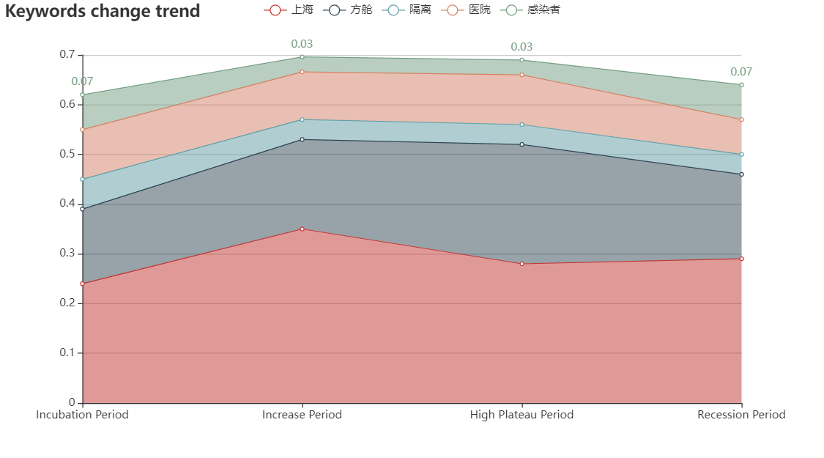
3.1 Hotspot analysis 热点分析
We can see from the keyword trend graph that keywords related to the epidemic are rising and then falling over time. This is consistent with the trend of the development of the epidemic.
我们可以通过关键词变化趋势图可以看到与疫情息息相关的关键词随着时间都是先上升后下降。这与疫情发展的趋势是一致的。

Slide 15
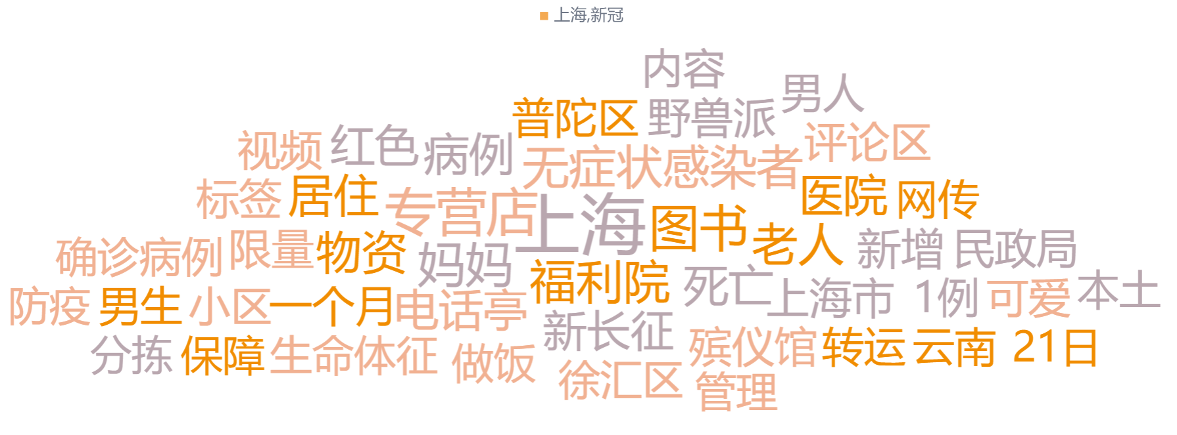
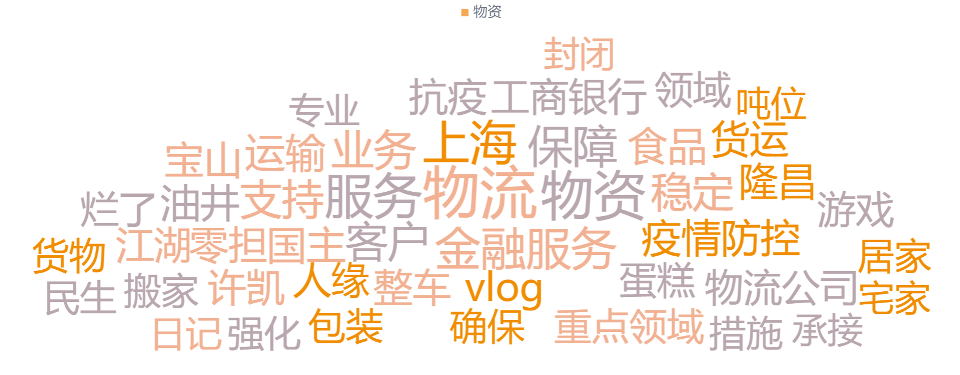
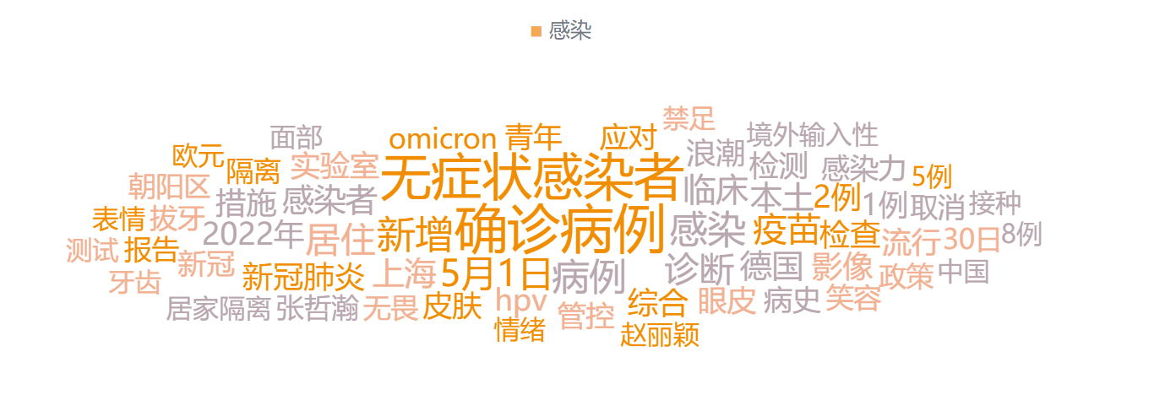
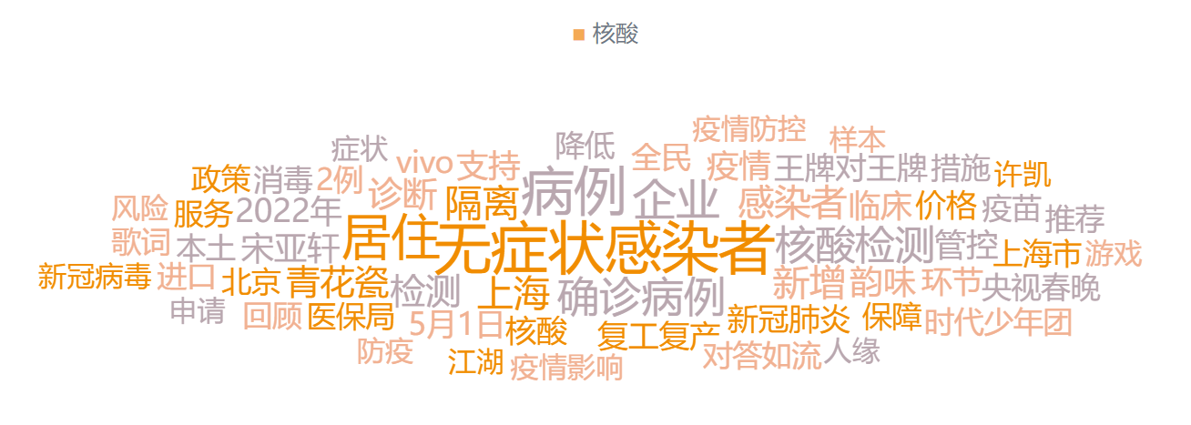
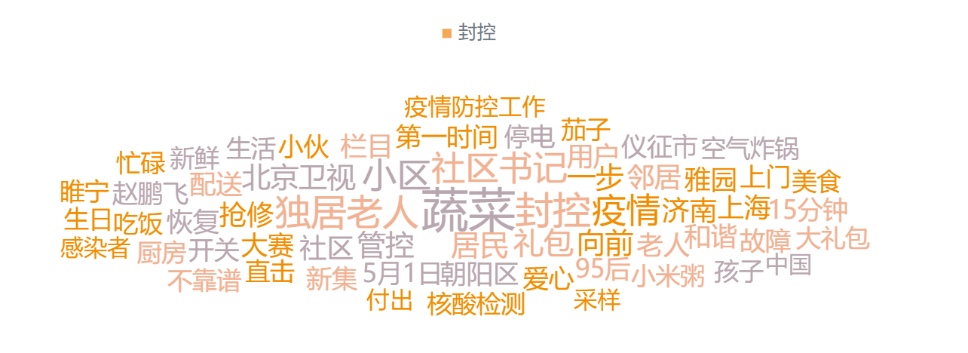
3.2 Co-occurrence analysis 共现分析
Internal relationship between these words?
When they appear together?
Which words have strong connection with other words?
Which words are at the core of the discussion?
Which words are excluded from others?
1.Binary co-occurrence matrix
2.Co-word matrix
3.Co-word network diagram
Analysis method？
90932 texts
词语之间的关系？
何时共同出现？
哪些词语之间有强关联性？
哪些词语是被讨论的核心？
哪些词语与其他词语没有较大联系？
分析方法?
1.二元共现矩阵
2.共词矩阵
3.共词网络
90932条文本

Slide 16
3.2 Co-occurrence analysis 共现分析
3.2.1 Binary co-occurrence matrix
上海 | 方舱 | 解封 | 医院 | 微博 | 核酸 | 视频 | 隔离 | 防控 | 无症状 | 感染者 | 小区 | 物资 | 新冠 | 确诊 | 抗疫 | 加油 | 医疗队 | 阳性 | 新增
0 | 1 | 0 | 1 | 0 | 0 | 1 | 0 | 0 | 0 | 0 | 0 | 0 | 0 | 0 | 0 | 0 | 0 | 0 | 0
0 | 1 | 0 | 1 | 0 | 0 | 0 | 0 | 0 | 0 | 0 | 0 | 0 | 0 | 0 | 0 | 0 | 0 | 0 | 0
0 | 1 | 0 | 1 | 0 | 0 | 0 | 1 | 0 | 0 | 0 | 0 | 1 | 1 | 1 | 0 | 1 | 0 | 0 | 1
0 | 1 | 0 | 1 | 0 | 0 | 0 | 0 | 0 | 0 | 0 | 0 | 0 | 0 | 0 | 0 | 0 | 0 | 0 | 0
0 | 0 | 0 | 0 | 1 | 0 | 1 | 0 | 0 | 0 | 0 | 0 | 0 | 0 | 0 | 0 | 0 | 0 | 0 | 0
0 | 1 | 0 | 1 | 0 | 0 | 0 | 0 | 0 | 0 | 0 | 0 | 0 | 0 | 0 | 0 | 1 | 0 | 0 | 0
0 | 1 | 0 | 1 | 0 | 0 | 0 | 1 | 0 | 0 | 0 | 0 | 0 | 0 | 0 | 0 | 0 | 0 | 0 | 0
0 | 1 | 0 | 1 | 0 | 0 | 0 | 0 | 0 | 0 | 0 | 0 | 0 | 0 | 0 | 0 | 0 | 0 | 0 | 0
0 | 1 | 0 | 1 | 0 | 0 | 0 | 0 | 0 | 0 | 0 | 0 | 0 | 0 | 0 | 0 | 0 | 0 | 0 | 0
0 | 1 | 0 | 1 | 0 | 0 | 0 | 0 | 0 | 0 | 0 | 0 | 0 | 0 | 0 | 0 | 0 | 0 | 0 | 0
0 | 1 | 0 | 1 | 0 | 0 | 0 | 0 | 0 | 0 | 0 | 0 | 0 | 0 | 0 | 0 | 0 | 0 | 0 | 0
0 | 1 | 0 | 1 | 0 | 0 | 0 | 0 | 0 | 0 | 0 | 0 | 0 | 0 | 0 | 0 | 0 | 0 | 0 | 0
0 | 1 | 0 | 1 | 1 | 0 | 1 | 0 | 0 | 0 | 0 | 0 | 0 | 0 | 0 | 0 | 0 | 0 | 0 | 0
0 | 1 | 0 | 1 | 0 | 0 | 0 | 0 | 0 | 0 | 0 | 1 | 0 | 0 | 0 | 0 | 0 | 0 | 0 | 0
0 | 0 | 0 | 0 | 0 | 0 | 0 | 0 | 0 | 0 | 0 | 0 | 0 | 0 | 1 | 0 | 0 | 0 | 0 | 1
0 | 1 | 0 | 1 | 0 | 0 | 0 | 0 | 0 | 0 | 0 | 0 | 0 | 0 | 0 | 0 | 0 | 0 | 0 | 0
0 | 1 | 0 | 1 | 1 | 0 | 1 | 1 | 0 | 0 | 0 | 0 | 0 | 0 | 0 | 0 | 0 | 0 | 0 | 0
0 | 1 | 0 | 1 | 0 | 0 | 0 | 0 | 0 | 0 | 0 | 0 | 0 | 0 | 0 | 0 | 0 | 0 | 0 | 0
0 | 1 | 0 | 1 | 0 | 0 | 1 | 0 | 0 | 0 | 0 | 0 | 0 | 0 | 0 | 0 | 0 | 0 | 0 | 0
0 | 1 | 0 | 1 | 0 | 0 | 0 | 0 | 0 | 0 | 0 | 0 | 0 | 0 | 0 | 0 | 0 | 0 | 0 | 0
0 | 1 | 0 | 1 | 0 | 0 | 0 | 0 | 0 | 0 | 0 | 0 | 0 | 0 | 0 | 0 | 0 | 0 | 0 | 0
0 | 1 | 0 | 1 | 0 | 0 | 0 | 1 | 1 | 0 | 0 | 0 | 0 | 0 | 0 | 1 | 0 | 0 | 0 | 0
Section of the matrix 矩阵节选

Slide 17
3.2 Co-occurrence analysis 共现分析
3.2.1 Binary co-occurrence matrix
Systematic cluster analysis—— the square of Euclidean distance
集中计划
阶段 | 组合聚类 |  | 系数 | 首次出现聚类的阶段 |  | 下一个阶段
 | 聚类 1 | 聚类 2 |  | 聚类 1 | 聚类 2
1 | 13 | 18 | 145 | 0 | 0 | 4
2 | 2 | 4 | 213 | 0 | 0 | 18
3 | 5 | 7 | 309 | 0 | 0 | 16
4 | 13 | 19 | 319.5 | 1 | 0 | 5
5 | 13 | 16 | 388.667 | 4 | 0 | 8
6 | 10 | 20 | 408 | 0 | 0 | 7
7 | 10 | 15 | 498 | 6 | 0 | 9
8 | 3 | 13 | 551 | 0 | 5 | 10
9 | 10 | 11 | 625 | 7 | 0 | 11
10 | 3 | 17 | 768.2 | 8 | 0 | 11
11 | 3 | 10 | 804.917 | 10 | 9 | 12
12 | 3 | 14 | 1117.6 | 11 | 0 | 13
13 | 3 | 12 | 1236.273 | 12 | 0 | 14
14 | 3 | 9 | 1382.583 | 13 | 0 | 15
15 | 3 | 8 | 1437.462 | 14 | 0 | 16
16 | 3 | 5 | 1486.571 | 15 | 3 | 17
17 | 3 | 6 | 1638.75 | 16 | 0 | 18
18 | 2 | 3 | 2276.559 | 2 | 17 | 19
19 | 1 | 2 | 8553.895 | 0 | 18 | 0
Working principle:
1.Import SPSS
2.Systematic cluster analysis
3.Classify two by two repeadly
Because the amount of data is too large, we process it through Python and finally get the data format shown in the figure. (see the attachment for Python code) then use SPSS software to conduct systematic cluster analysis (the specific method is to calculate the square of Euclidean distance), classify several similar keywords into several categories, and next classify the two categories with high similarity into a new category, and then repeat this process until all keywords are classified into one category.
Process of clustering 聚类过程

Slide 18
3.2 Co-occurrence analysis 共现分析
3.2.1 Binary co-occurrence matrix
Systematic cluster analysis—— the square of Euclidean distance
Most of the current situation and assistance come from the care of residents and netizens in other provinces and cities for the people suffering from the epidemic in Shanghai, so they are grouped into one category in the second step;
The prevention and control category comes from the attention of local residents to their current living situation. They establish contact with the outside world by means of weibo and online video to meet their social needs.
The above sources of public opinion are uninfected residents(they all need nucleic acid testing everyday), while the treatment category comes from the reports of the government and state media and the concerns of the sick people about their expectations for future life.
Therefore, it is finally summed up with the above three categories.
And Shanghai is only the carrier of the epidemic and has no direct connection with the psychological activities of people, so it is independent.
assistance category
the current situation category
prevention and control category
treatment category

Slide 19
3.2 Co-occurrence analysis 共现分析
3.2.2 Co-word matrix and the network diagram
Co-word network / Social network
When talking about the research on network relations, we often pay attention to the network formed by social relations. For example, this kind of people do not get along with that kind of people, resulting in social differentiation. In fact, the co-word network analysis we are concerned about is actually a kind of social network analysis. However, we have adopted the text on social media as the research carrier, maybe the more common carrier is the traffic path, etc.

Slide 20
3.2 Co-occurrence analysis 共现分析
3.2.2 Co-word matrix and the network diagram
Co-word matrix
共词 矩阵 | 上海 | 方舱 | 解封 | 医院 | 微博 | 核酸 | 视频 | 隔离 | 防控 | 无症状 | 感染者 | 小区 | 物资 | 新冠 | 确诊 | 抗疫 | 加油 | 医疗队 | 阳性 | 新增
上海 | 90376 | 16248 | 26980 | 16760 | 11363 | 8407 | 11141 | 7353 | 6779 | 5944 | 3930 | 6632 | 6838 | 4836 | 6081 | 4326 | 6058 | 2620 | 4051 | 6238
方舱 | 16248 | 16696 | 272 | 16037 | 4558 | 1988 | 4672 | 2896 | 1816 | 1502 | 2234 | 668 | 758 | 1974 | 1194 | 1336 | 1211 | 2285 | 2036 | 984
解封 | 26980 | 272 | 26990 | 386 | 1303 | 2573 | 1191 | 1563 | 539 | 2814 | 378 | 2990 | 1450 | 453 | 3036 | 522 | 1642 | 64 | 830 | 3170
医院 | 16760 | 16037 | 386 | 17212 | 4620 | 2187 | 4731 | 2875 | 1987 | 1563 | 2306 | 711 | 769 | 2083 | 1253 | 1415 | 1240 | 2371 | 2059 | 1037
微博 | 11363 | 4558 | 1303 | 4620 | 11608 | 1263 | 10203 | 1477 | 1601 | 929 | 977 | 710 | 944 | 1344 | 849 | 1138 | 1431 | 1443 | 506 | 824
核酸 | 8407 | 1988 | 2573 | 2187 | 1263 | 8438 | 1278 | 1728 | 1579 | 878 | 859 | 1799 | 784 | 1154 | 998 | 744 | 825 | 596 | 1414 | 813
视频 | 11141 | 4672 | 1191 | 4731 | 10203 | 1278 | 11392 | 1524 | 1580 | 907 | 990 | 707 | 934 | 1335 | 815 | 1144 | 1467 | 1495 | 506 | 784
隔离 | 7353 | 2896 | 1563 | 2875 | 1477 | 1728 | 1524 | 7519 | 1165 | 991 | 1163 | 926 | 655 | 1203 | 1045 | 571 | 563 | 202 | 1272 | 828
防控 | 6779 | 1816 | 539 | 1987 | 1601 | 1579 | 1580 | 1165 | 6830 | 923 | 1295 | 537 | 652 | 2152 | 765 | 714 | 534 | 462 | 1004 | 746
无症状 | 5944 | 1502 | 2814 | 1563 | 929 | 878 | 907 | 991 | 923 | 5958 | 1865 | 515 | 335 | 1180 | 4625 | 220 | 477 | 263 | 630 | 4545
感染者 | 3930 | 2234 | 378 | 2306 | 977 | 859 | 990 | 1163 | 1295 | 1865 | 3938 | 234 | 231 | 1619 | 1049 | 254 | 339 | 407 | 1337 | 1192
小区 | 6632 | 668 | 2990 | 711 | 710 | 1799 | 707 | 926 | 537 | 515 | 234 | 6649 | 1282 | 460 | 754 | 435 | 462 | 40 | 793 | 600
物资 | 6838 | 758 | 1450 | 769 | 944 | 784 | 934 | 655 | 652 | 335 | 231 | 1282 | 6870 | 314 | 363 | 1040 | 726 | 232 | 326 | 353
新冠 | 4836 | 1974 | 453 | 2083 | 1344 | 1154 | 1335 | 1203 | 2152 | 1180 | 1619 | 460 | 314 | 4985 | 1053 | 498 | 434 | 428 | 841 | 988
确诊 | 6081 | 1194 | 3036 | 1253 | 849 | 998 | 815 | 1045 | 765 | 4625 | 1049 | 754 | 363 | 1053 | 6162 | 261 | 472 | 98 | 670 | 4516
抗疫 | 4326 | 1336 | 522 | 1415 | 1138 | 744 | 1144 | 571 | 714 | 220 | 254 | 435 | 1040 | 498 | 261 | 4417 | 763 | 588 | 310 | 217
加油 | 6058 | 1211 | 1642 | 1240 | 1431 | 825 | 1467 | 563 | 534 | 477 | 339 | 462 | 726 | 434 | 472 | 763 | 6076 | 488 | 234 | 463
医疗队 | 2620 | 2285 | 64 | 2371 | 1443 | 596 | 1495 | 202 | 462 | 263 | 407 | 40 | 232 | 428 | 98 | 588 | 488 | 2623 | 122 | 95
阳性 | 4051 | 2036 | 830 | 2059 | 506 | 1414 | 506 | 1272 | 1004 | 630 | 1337 | 793 | 326 | 841 | 670 | 310 | 234 | 122 | 4063 | 656
新增 | 6238 | 984 | 3170 | 1037 | 824 | 813 | 784 | 828 | 746 | 4545 | 1192 | 600 | 353 | 988 | 4516 | 217 | 463 | 95 | 656 | 6274
Co-word matrix 共词矩阵

Slide 21
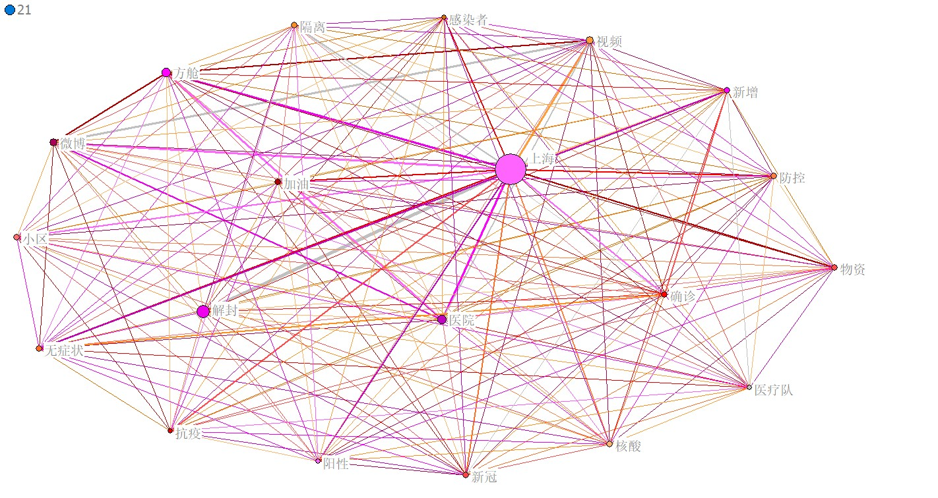
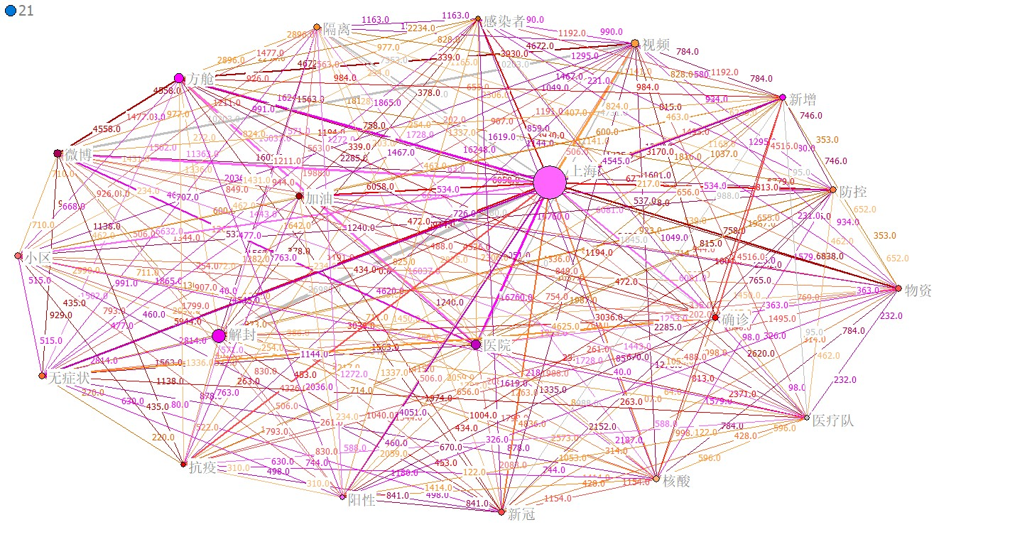
3.2 Co-occurrence analysis 共现分析
3.2.2 Co-word matrix and the network diagram
UCIENT6 & Netdraw
Element 1:The size of each circle
The size of each circle represents the centrality of each keyword, that is, they are the core topic of discussion, and almost all other keywords are derived from them.
Element 2:The lines between each circle
The color of the line changes with the increase of closeness from red, yellow, orange and purple;
And the thickness of the line varies with the increase of tie strength. Closeness means the average shortest distance from a specific node to all other nodes, which is a manifestation of extreme value logic; Tie strength is measured according to the number of weibo texts contacted, so they are all integers.

Slide 22
3.2 Co-occurrence analysis 共现分析
3.2.2 Co-word matrix and the network diagram
Network diagram

Slide 23

3.2 Co-occurrence analysis 共现分析
The logic of Netizens
What is the problem?
Whether the problem has been solved?
But there is a lack of "how to solve the problem", which is due to the fact that the text data of social media are mostly the venting of residents' emotions (some are positive and some are negative). There exist some evaluations, but they have not put forward practical solutions to the epidemic.
Be rational!!!
This is a serious problem in the current network society.

Slide 24




3.3 Residents demand temporal evolution analysis 居民需求时序演化
Words frequency: What people are looking at?
词频；舆情关注点
Incubation Period Word cloud 潜伏期词云
Increase Period Word cloud 增长期词云
High Plateau Period Word cloud 高位平台期词云
Recession Period Word cloud 下降期词云

Slide 25
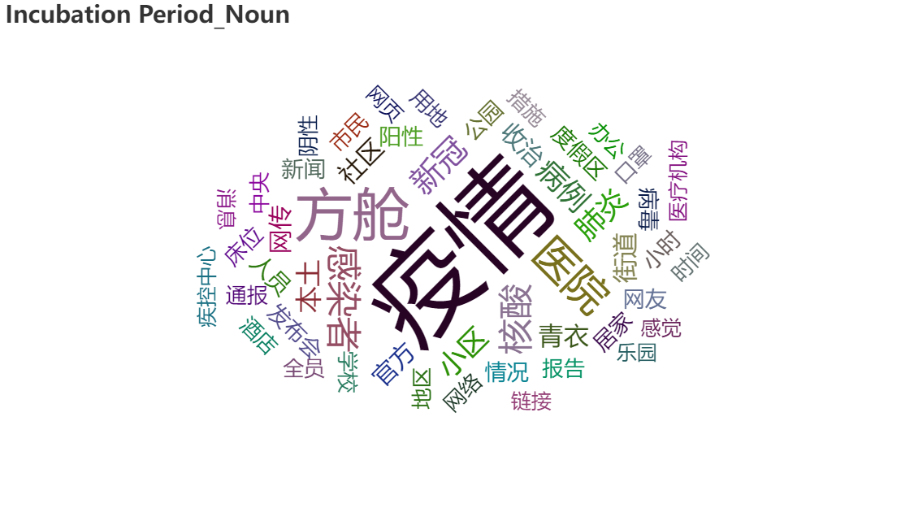
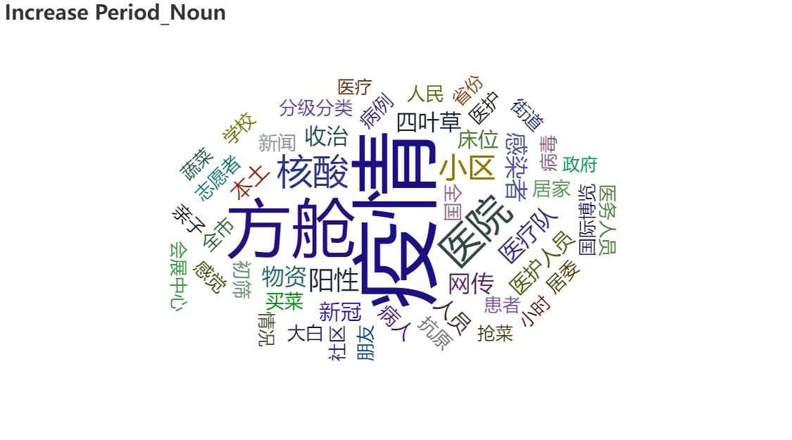
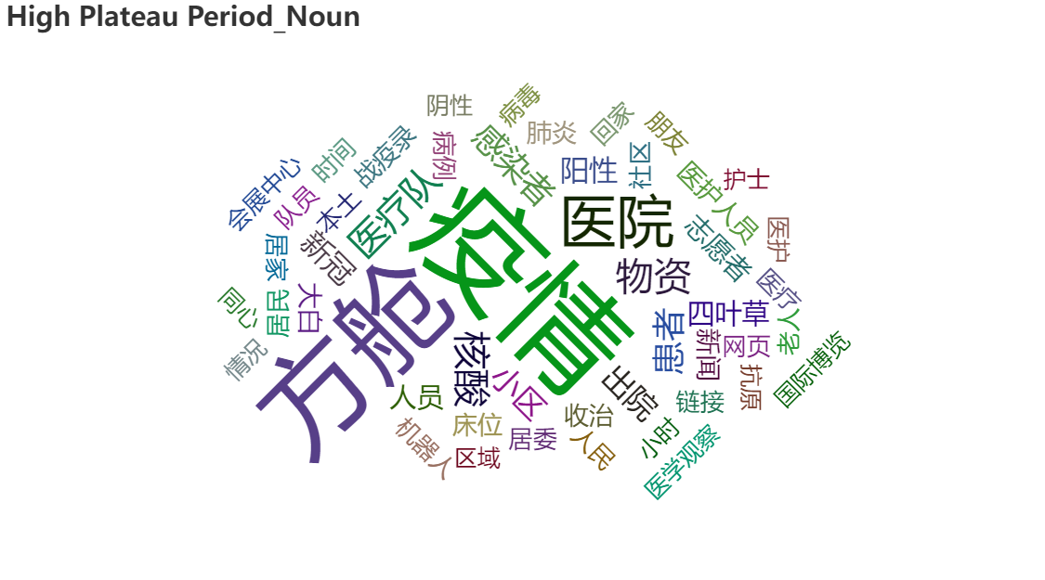
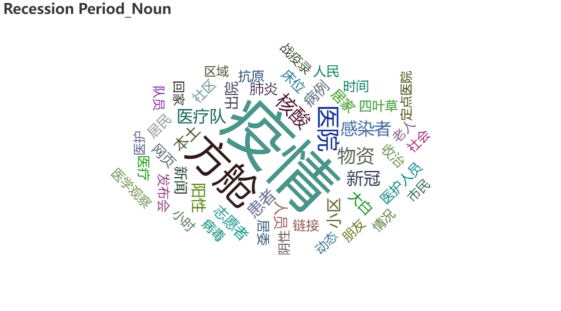
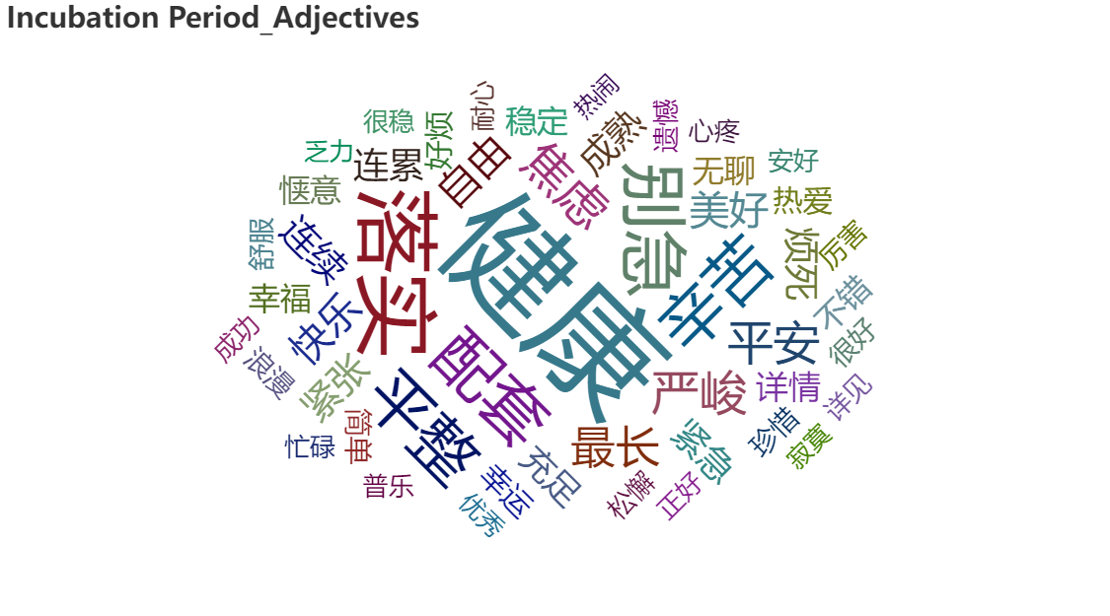
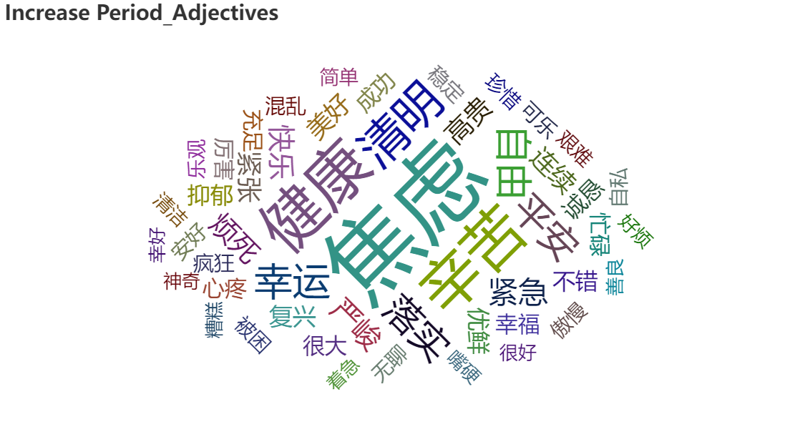
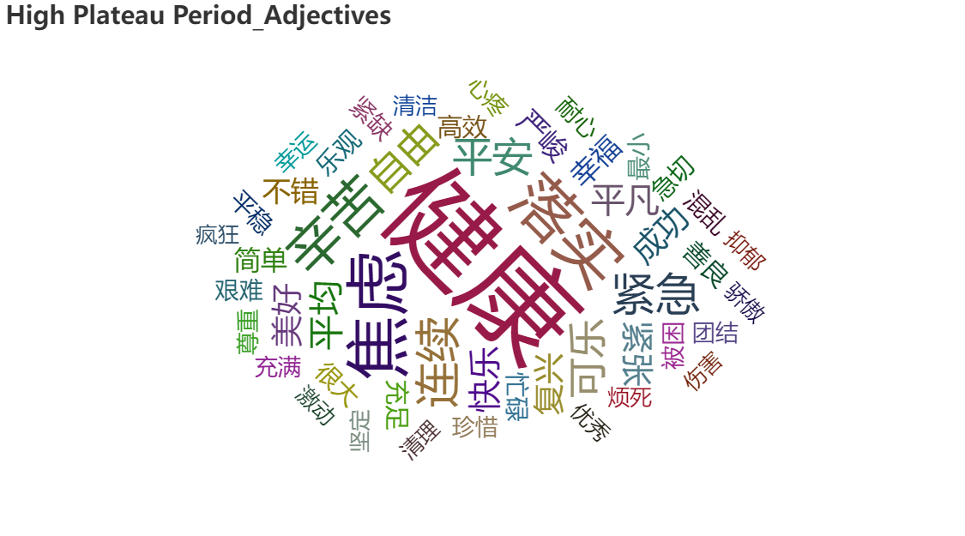
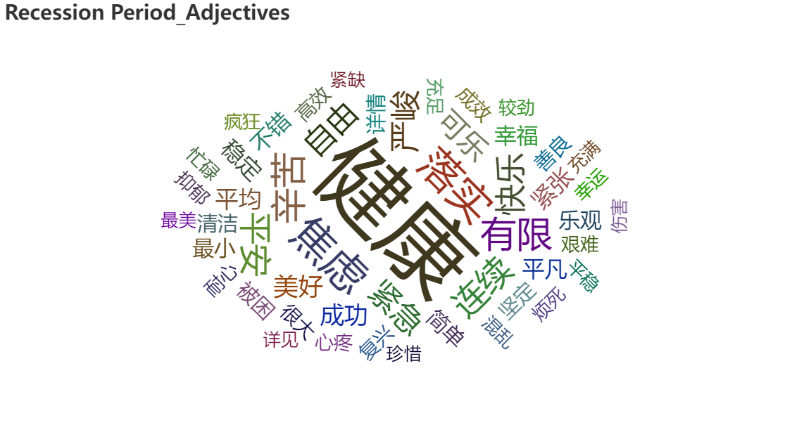
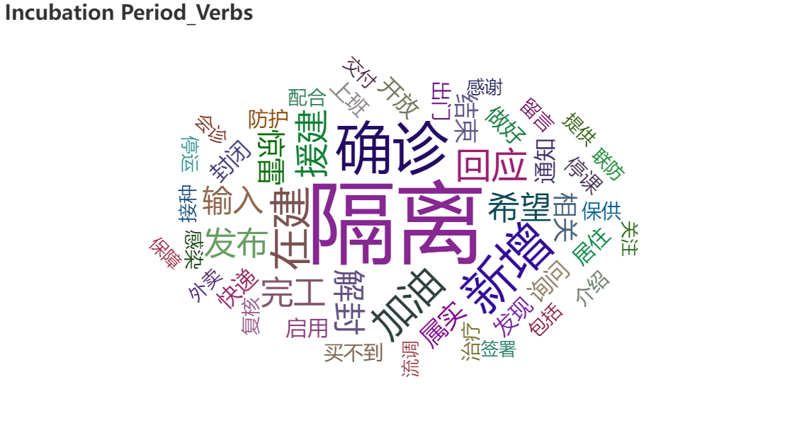
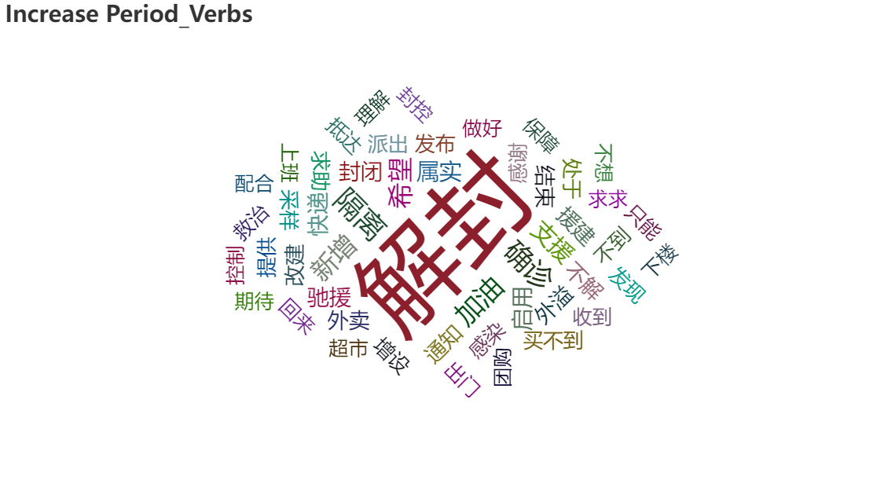
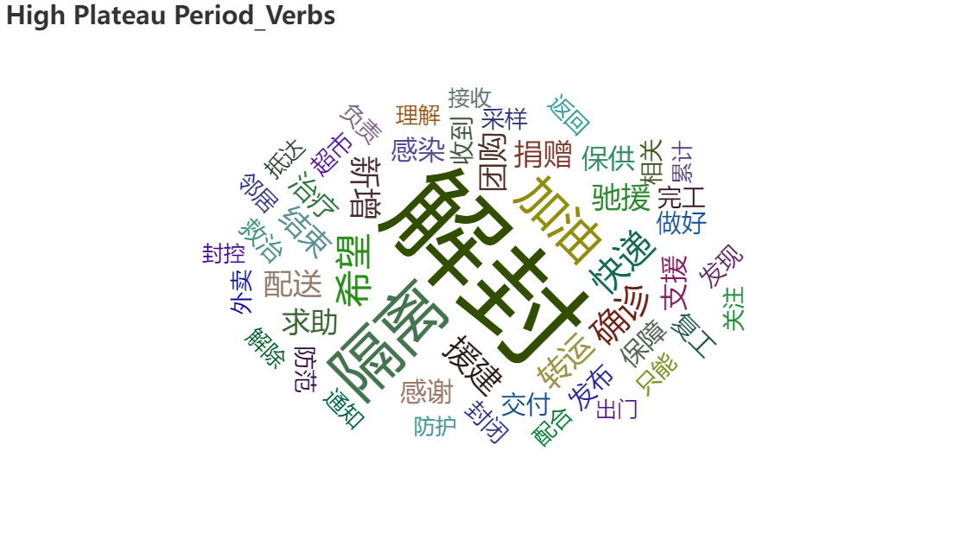
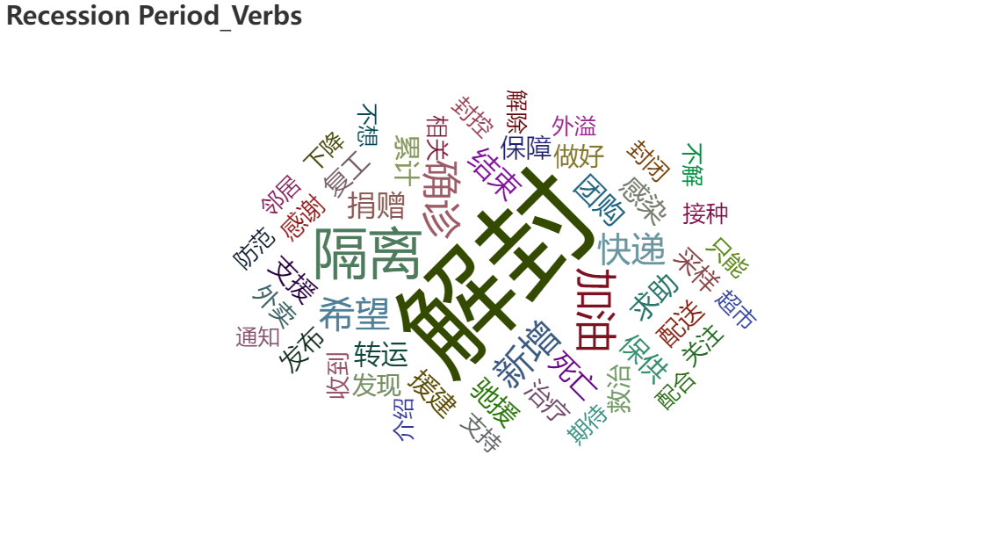
3.3 Residents demand temporal evolution analysis 居民需求时序演化
Part of speech: Who people are looking at?
词性分析；舆情关注对象
Noun
Adjectives
Verbs
Incubation Period
Increase Period
High Plateau Period
Recession Period

Slide 26

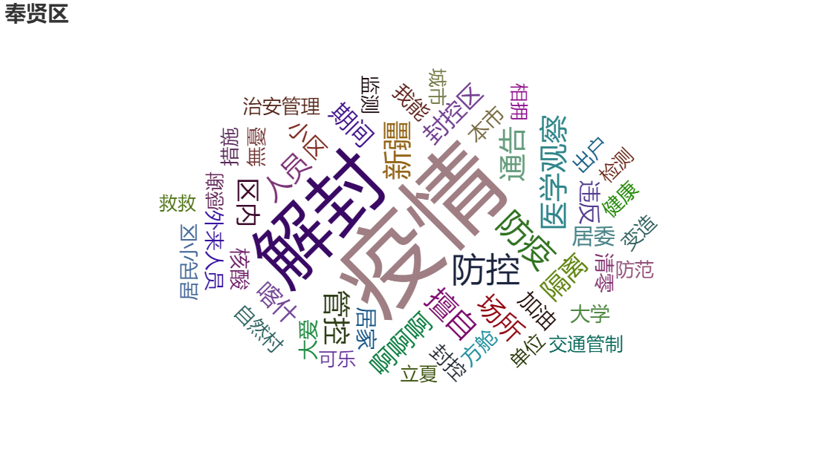
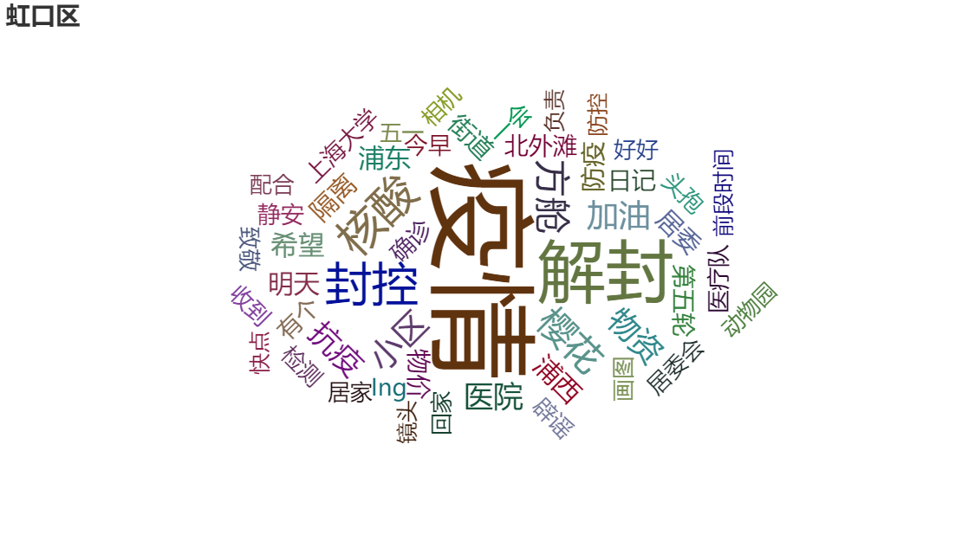

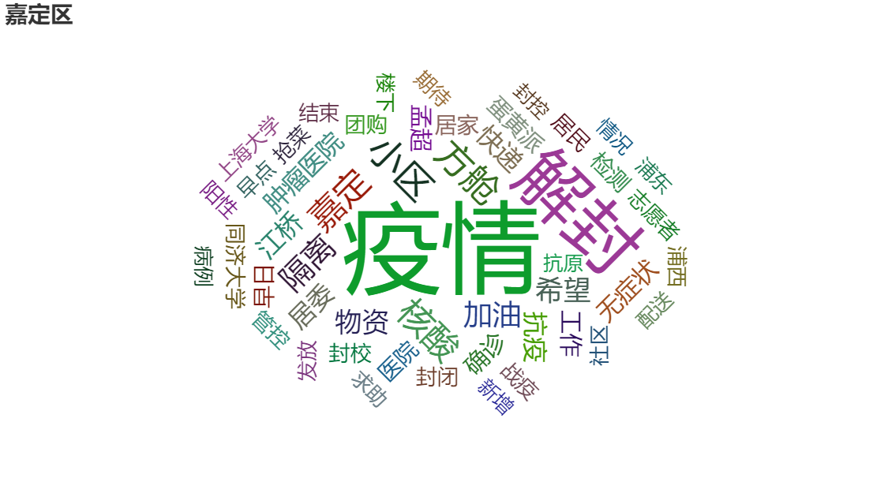
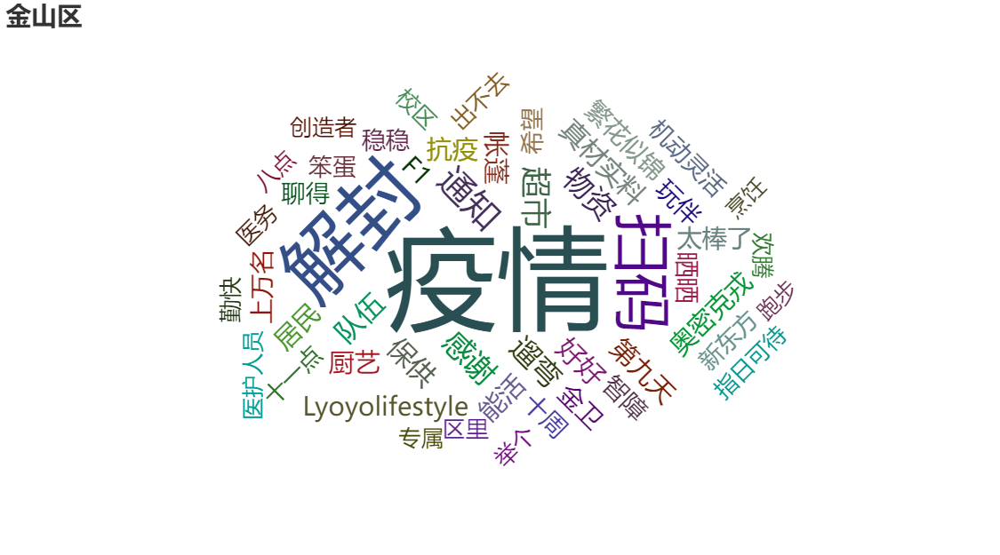
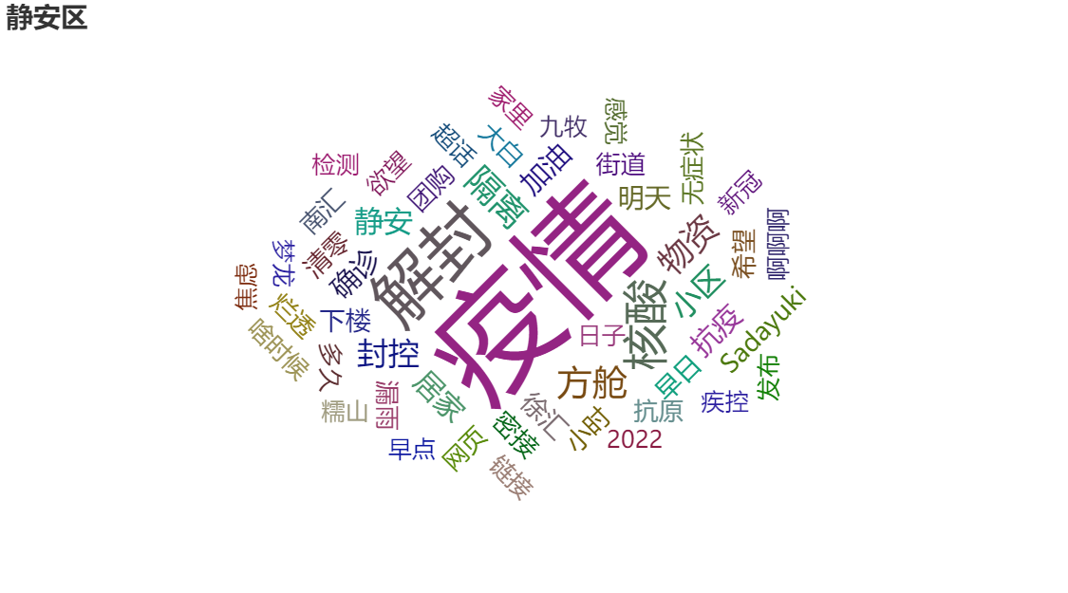






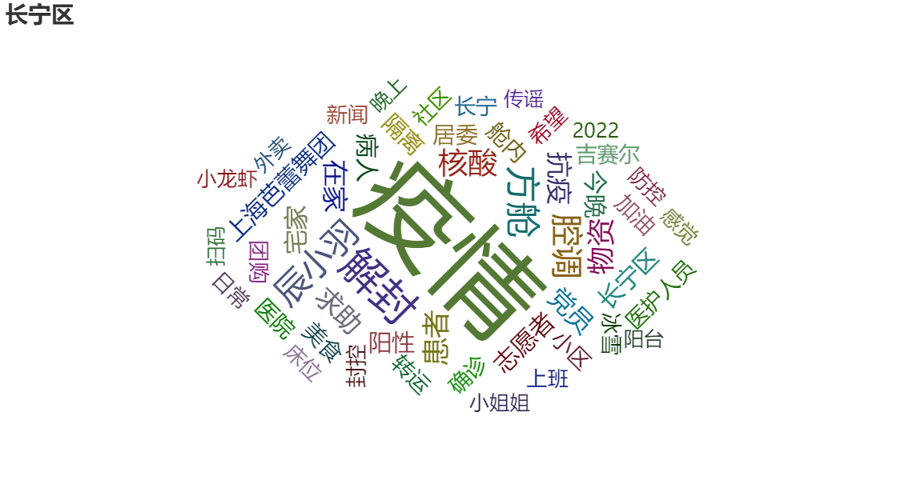
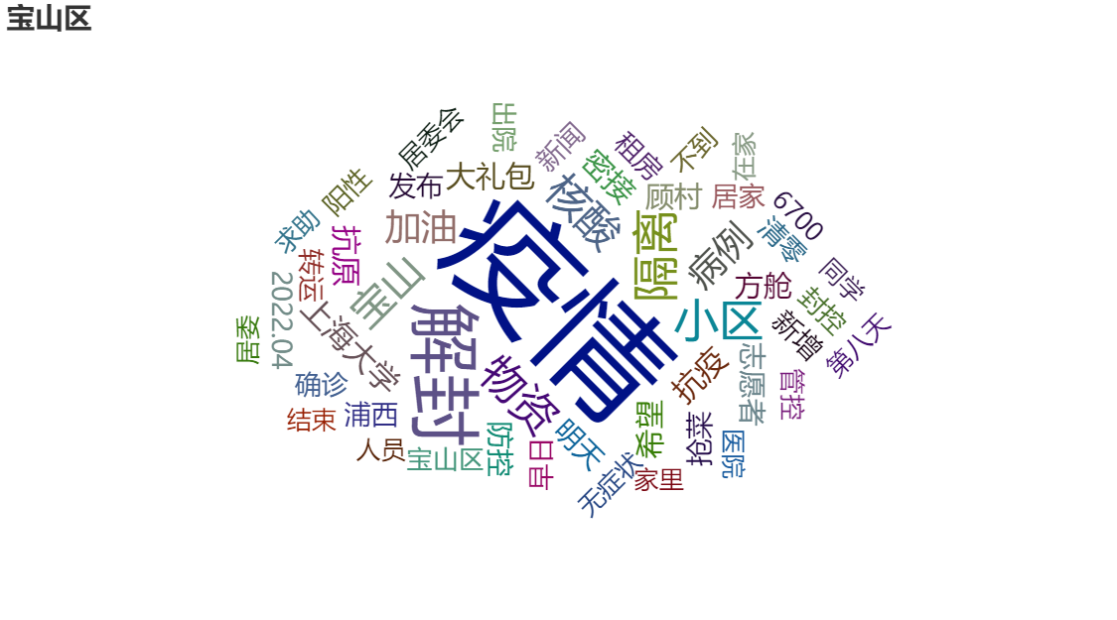
3.4 Residents demand space differentiation 居民需求空间分异
Public opinion analysis by district
全阶段分区词云

Slide 27
04
Sentiment analysis and visualization
情感感知分析与可视化
04
4.1 Sentimental data statistics 情感数据统计
4.2 Evolution of residents’ sentiments 居民情感演化分析
4.3 Spatial differentiation of residents’ sentiments 居民情感的空间分异
4.4 Attribution analysis of sentimental perception differences 情感感知差异归因分析

Slide 28
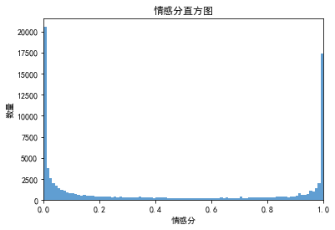
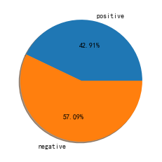
4.1 Sentimental data statistics 情感数据统计
emotion
count | 90932.000000
mean | 0.440691
std | 0.422244
min | 0.000000
25% | 0.015180
50% | 0.286757
75% | 0.957516
max | 1.000000
SnowNLP, python
Sentiment scores greater than 0.5 were identified as positive comments, while the rest were identified as negative comments.
The overall sentiment scores showed both extremes, but the overall number of negative tweets was higher.
采用python的SnowNLP库进行情感分析
情感分值大于0.5的被确定为正面评论，而其余的则被确定为负面评论
整体的情感分数显示出两个极端，但负面推文的整体数量较多

Slide 29
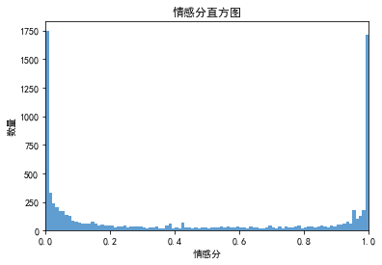
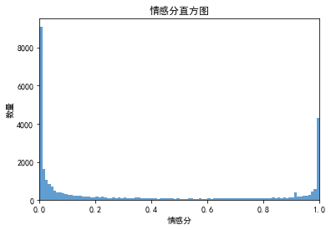
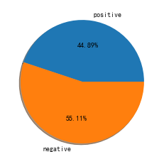
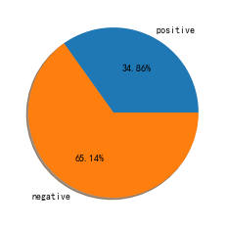
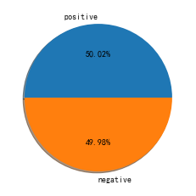
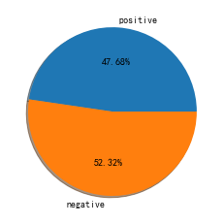
4.1 Sentimental data statistics 情感数据统计
It can be seen that the sentiment in the body of the tweets is all skewed to the two extremes, and in total there are more tweets with negative sentiment, except for the high plateau period.
可以看到微博正文的情感都是偏向两个极端，总量上除了高位平台期以外，其余都是负面情感的微博更多。
Incubation Period
Increase Period
High plateau Period
Recession Period
2022/3/1-2022/3/23
2022/3/24-2022/4/9
2022/4/9-2022/4/21
2022/4/21-2022/4/30

Slide 30
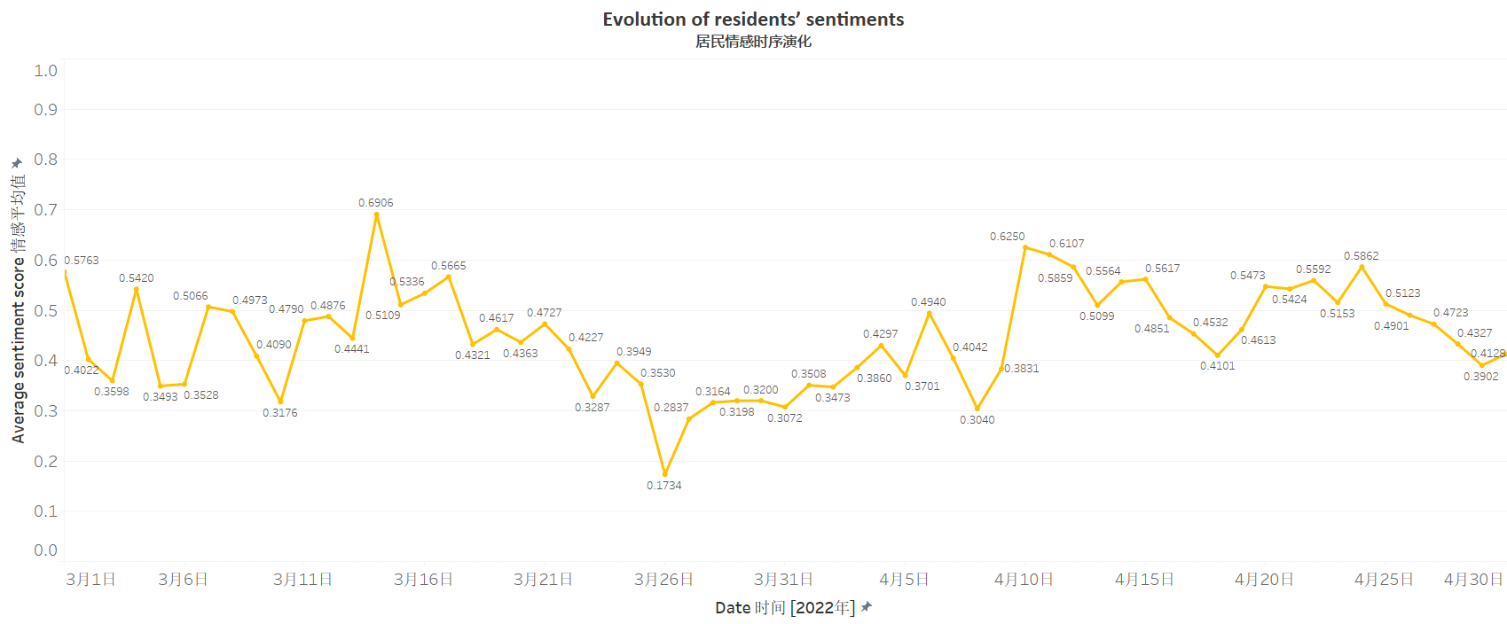
4.2 Evolution of residents’ sentiments 居民情感演化分析
4.12-Wenxiong Qian, the director of Shanghai Health Commission Information Center, suicided
3.12-Primary and secondary schools have started online teaching
4.15-Jingdong supports Shanghai in a suicidal logistics
4.22-Phenomenal spread of a video named Voice of April
3.1-First locally confirmed case
3.28-Pudong lockdown
4.1-Puxi lockdown
4.26-First zero community transmission day of Shanghai
3.16-Grid screening nucleic acids
4.4-Shanghai lockdown
4.2-Chunlan Sun arrived in Shanghai to guide epidemic prevention and control
4.18-Online videos shows supplies from Liaoning were discarded
Incubation Period
(3.1-3.24)
Increase Period
(3.25-4.10)
High Plateau Period
(4.10-4.22)
Recession Period
(4.23-4.30)
潜伏期
增长期
高位平台期
下降期

Slide 31
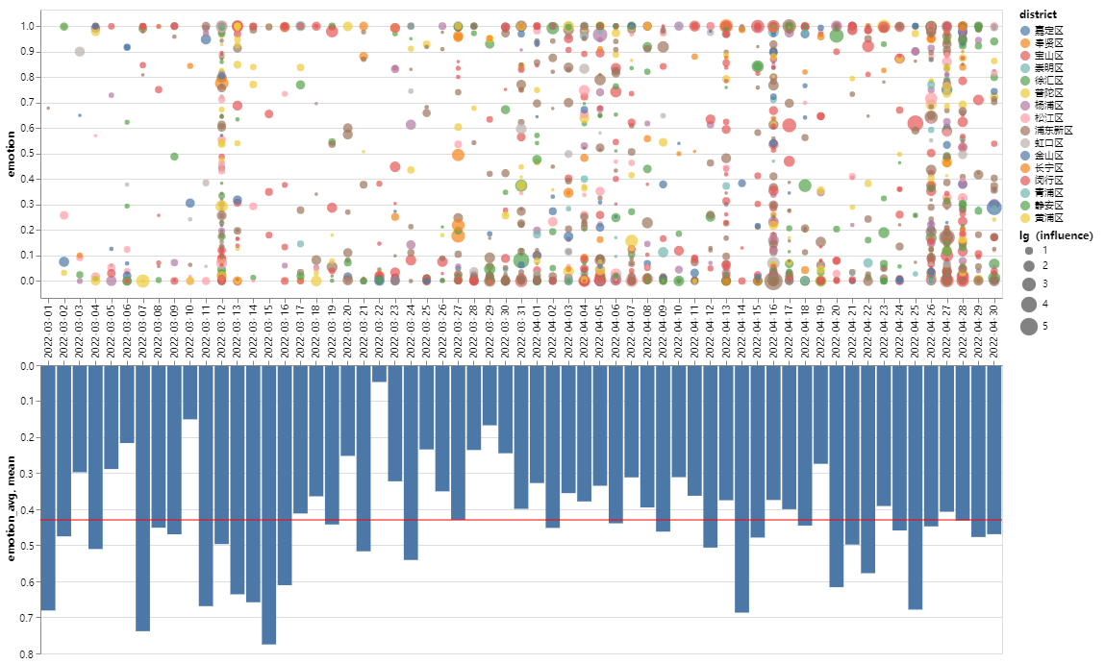
4.2 Evolution of residents’ sentiments 居民情感演化分析
Visualization
Scatter plots and bar charts are drawn based on all emotion data within the study area. As shown in the top left panel, each point represents the emotion value of a tweet content, different colors represent different zones, and the size of the point indicates the influence of the tweet.
It can be seen that the distribution of emotion values is more polarized, and as the epidemic develops, the number of people involved in the discussion of the epidemic in Shanghai is increasing.

Slide 32
4.2 Evolution of residents’ sentiments 居民情感演化分析
Visualization
Based on this, the average sentiment value for each day was also counted, as shown in the bottom left graph, with a mean value of 0.42, indicating an overall negative emotion.
This negative sentiment reached its peak when the number of people in the epidemic was growing the fastest. Later, as the epidemic gradually stabilized, the residents’ emotion gradually tilted towards the positive side.

Slide 33
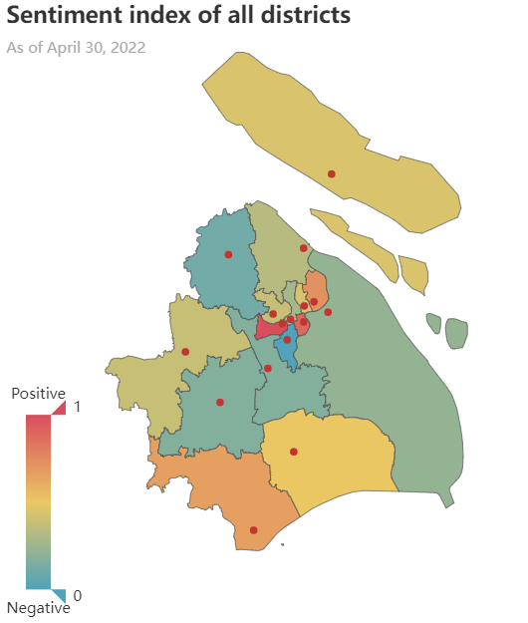

4.3 Spatial differentiation of residents’ sentiments 居民情感的空间分异

Slide 34

4.3 Spatial differentiation of residents’ sentiments 居民情感的空间分异
Based on the summary statistics, the district-based emotion map of Shanghai public opinion is drawn in four periods, with lighter colors indicating stronger negative sentiment. In the whole process, it can be seen that the emotion value dominated by negative sentiment (<0.5).
Incubation period: There were few discussions about the "Shanghai epidemic", and the overall emotion was positive, but the more serious the epidemic was, the higher the negative sentiment was.
Growth period: Emotion across Shanghai has dropped significantly, and this is the strongest period of negative sentiment.
High plateau period: With the change of policy, there is a trend of easing of residents' sentiment.
Recession period: With the decrease in the number of case growth, and the gradual increase in material capacity, positive emotions are becoming more and more frequent.

Slide 35
4.4 Attribution analysis of sentimental perception differences 情感感知差异归因分析
The impact of some news events.
The gradual opening of logistics channels.
Such influence is difficult to form the law of tendency, and they are often mixed.
The epidemic situation in Shanghai has gradually spread outward, while it has eased locally. At the same time, the care from all over the country moved the people of Shanghai, which is also a positive emotion.
Residents' psychological law.
The spread of the epidemic
In fact, when the epidemic continues to deteriorate, it is the time when everyone is most desperate. At the high platform stage, everyone is used to the changed life, so it presents a balanced situation to a certain extent.
The difference in the spatial distribution of emotional values is directly related to the spread of the epidemic, and they all show a trend of spreading from the center to the surrounding.

Slide 36
05
The cognition of public opinion from the perspective of urban planning
城市规划视角下对舆情的认知
05
5.1 Comparison between official media and Weibo post 官方媒体发布内容与微博博文对比
5.2 Public feedback on urban epidemic prevention policies 城市防疫政策的公众反馈
5.3 Strategies from the perspective of urban planning 城市规划视角的策略

Slide 37



5.1 Comparison between official media and Weibo post 官方媒体发布内容与微博博文对比
What kind of data can represent the official?
The strategy of planning and responding to the epidemic often takes the policy as the direct means of implementation. Therefore, before putting forward specific measures, we hope to make some understanding of the official concerns about the epidemic. We found that most of the documents about the "Shanghai epidemic" published by CNKI are newspapers. The information carried by this kind is reviewed by the government and then sent out. It is full of official elements, which more or less provides some government concerns and its force to lead the public opinion.

Slide 38


5.1 Comparison between official media and Weibo post 官方媒体发布内容与微博博文对比
The complete network diagram
We use VOSviewer software to analyze the text data (353 copies in total) of journals and newspapers exported from CNKI during the period from March 1, 2022 to April 30, 2022. The main method is to extract the keywords for co-occurrence analysis.
Image Reading:
Size - weight. The larger the sphere, the higher the weight, indicating that the centrality is the highest and is the core concern;
Colour - The key words in the same category are in the first place, and the other make little difference and are painted in gray;
Line - the strength of the connection. The stronger the connection, the thicker the line.

Slide 39


5.1 Comparison between official media and Weibo post 官方媒体发布内容与微博博文对比
Without the keywords with low frequency
If the keywords with low frequency of peripheral relations are excluded, the official core concerns can be more clearly expressed. It can be found that many topics related to governance and Party building have been put at the core.

Slide 40




5.1 Comparison between official media and Weibo post 官方媒体发布内容与微博博文对比
More details

Slide 41


5.1 Comparison between official media and Weibo post 官方媒体发布内容与微博博文对比
The conflicts
Government
Residents
Supply side: Top-down
Transportation
Industry
Economy
Future prospects
Demand side: Bottom-up
material supply
community unsealing
hospital treatment
isolation

Slide 42
5.2 Public feedback on urban epidemic prevention policies 城市防疫政策的公众反馈
The time-series analysis of sentiment analysis shows that the more effective and timely the measures taken by government departments to deal with the incident, the higher the sentiment value of users in the rising and stable periods. From the perspective of geographical distribution, the degree of public opinion is directly proportional to the severity of the local epidemic, but the fluctuation of sentiment value is less correlated with the number of confirmed cases and positively correlated with the timeliness, reasonableness and effectiveness of the local government's response to people's needs and public opinion.
The word cloud analysis of different time periods shows that although people's concerns are different at different stages of the epidemic, "expressing and venting their emotions through online media" is the primary demand of people's voices. The government should detect people's emotions in real time, assess their mental health status and provide mental assistance if necessary; in addition, the government should investigate public attitudes and give adequate and timely responses.

Slide 43


5.3 Strategies from the perspective of urban planning
experience
problem
principle
measures
This section mainly puts forward and finds solutions to alleviate epidemic problems from the perspective of urban planning. This is different from the public opinion analysis of residents' needs in the previous article, because the planning has always been a top-down regulation. We can only find some strategies that can meet the needs of residents in this top-down logic. The general process is to sum up experience, analyze and summarize the current problems from public opinion, and then put forward some solutions according to the macro guiding principles.

Slide 44

5.3 Strategies from the perspective of urban planning 城市规划视角的策略
Experience 1-From the history
Image: Development context of urban planning and public health; source：《城市规划与公共卫生的渊源、发展与演进》（杨瑞、欧阳伟、田莉《上海城市规划》）
Urban planning originated from public health problems and was inseparable from it for a long time.
Today's situation is actually similar to the difficulties encountered by Britain in those years, but we have more methods because of technological progress.

Slide 45


5.3 Strategies from the perspective of urban planning 城市规划视角的策略
Experience 1-From the history : the Cholera map
Image: John Snow and his Cholera map ; source：https://image.baidu.com
The victory of information design
The similar method has developed into a smart city today, which can be used in many cases of the epidemic control.

Slide 46

5.3 Strategies from the perspective of urban planning 城市规划视角的策略
Experience 2-Operation mechanism of the Resilient City
01
02
03
Structural
resilience
Procedural
resilience
Systematic
resilience
Technical resilience
Economical resilience
Social resilience
Governmental resilience
The city's response ability in the whole life cycle when facing the sudden disasters
As a living body, the city has the ability to coordinate various elements and make them form internal consistency.

Slide 47

5.3 Strategies from the perspective of urban planning 城市规划视角的策略
Problems & Principles
Problems:
Materials, nucleic acid test and home isolation have become normalized needs.
Official release information is opaque.
In the community structure and organizational level:
Community grass-roots organizations are suspended, and the community has responsibilities but no rights.
The workload of some industries will surge during the epidemic
Community identity and social organization
From the word
frequency analysis
Principles:
Community data network+ing
Community information transparent+ing
Community planning popularize+ing
Community governance integrate+ing
Spatial differentiation turn to specialize+ing

Slide 48

5.3 Strategies from the perspective of urban planning 城市规划视角的策略
Measures
01
01
Systematization of epidemic prevention and control
Fortification standards of different levels
Different partitions
Top-down management and control system
Image: Hierarchical relationship of epidemic prevention and control ; source：金锋淑 李岩 孔庆熔.韧性城市建设背景下疫情防控规划编制初步探讨[J].面向高质量发展的空间治理——2020中国城市规划年会论文集（01城市安全与防灾规划）:244-266

Slide 49

5.3 Strategies from the perspective of urban planning 城市规划视角的策略
Measures
However, the most practical work actually lies in the efforts of the grass-roots level. Many advocates of the community responsibility planner system can play a greater role.
01
02
Mobile community
staff
Full-time grass-roots employees;
This is a new flexible career;
Mobile community staff;
Insufficient labor force of volunteers
Image: Residential space prevention and control system ; Source: 丁楠.基于疫情防控视角的韧性城市规划对策[J].面向高质量发展的空间治理——2020中国城市规划年会论文集（01城市安全与防灾规划）:443-451

Slide 50



5.3 Strategies from the perspective of urban planning 城市规划视角的策略
Measures
03
01
Emergency management mechanism
Image : Plan of Century Avenue Subway Station
Source : http://news.66wz.com/
Autonomous switching
Emergency plans
Emergency industrial layout
Image : Shanghai rail transit route map
Source : https://item.jd.com/
Image : Residential streamline design
Source : https://bbs.zhulong.com/
For example, rail transit is the most fixed mode of transportation in the city (its lines are often fixed.) The lines with wide coverage can be selected as the emergency logistics carrier. The original transfer station can be used as a logistics hub, and it is possible to transform it into a virus elimination station.

Slide 51

5.3 Strategies from the perspective of urban planning 城市规划视角的策略
Measures
03
04
01
Intelligent detection and evaluation platform
Online system building
——Realize dynamic resilience
——track and analyze in real time.
Image : Examples of content included in online system ; Source : Author drawn
The greatest psychological comfort for residents is to let them see the efforts of the executive institution. This is a process of solving problems, but it should also be a process of publicity and visualization. Only when residents feel the application of high and new technology around them will they feel more secure.

Slide 52




5.3 Strategies from the perspective of urban planning 城市规划视角的策略
Measures
05
01
Application of mathematical model
Image : Examples of multilevel models
Source:https://zhuanlan.zhihu.com/p/50048784?utm_source=qq
Image : Tongji NCP-GIS
Source : https://www.sohu.com/a/374198113
Multilevel biomedical model
Pathogen tracking system
Estimation of isolation unit size
Image : Tongji NCP-GIS
Source : https://www.sohu.com/a/374198113
Image : Pathogenic nucleic acid test process
Source : https://www.sohu.com/a/471156794_121100999

Slide 53
06
Conclusion
结语
06
6 Conclusion 结语

Slide 54



6 Conclusion 结语
In previous studies, public opinion analysis has attracted more attention from journalism and sociology fields, and many of them involve the computer field. There are also a few studies on public policy and urban governance, but most of them are about how to guide the public opinion.
This study looked at public opinion from the perspective of urban planning and built space, analyzed the characteristics of public opinion, speculated the causes of public opinion, and tried to put forward strategies and possible methods based on urban planning and design according to the professional knowledge learned. In other words, we are trying to figure out how to change, what to do.
在过往的研究中，舆情分析更多的受到新闻学、社会学等领域的关注，也有许多涉及到计算机领域，在公共政策与城市治理方面也有少量研究，但更多的是从舆论层面进行引导。
本研究则是从城市规划与建成空间的视角看待舆情，分析舆情特征，推测舆情的产生原因，并尝试根据所学专业知识提出基于城市规划设计的策略和可能的方法。换句话说，我们正尝试找出怎样改变、如何去做。

Slide 55
6 Conclusion 结语
In today's increasingly developed Internet, public opinion is a mirror that reflects people's demands in real time and reflects the space for progress in urban construction.
Therefore, public opinion analysis in the field of urban planning is necessary. Keywords obtained by referring to big data can be used to quickly and accurately analyze the improvement measures of built space or urban governance. But at the same time, due to the high freedom of releasing information on the Internet platform, it is still difficult to identify the truth and falsehood of network information, which is also the direction of this kind of research can be optimized.
在互联网愈加发达的今天，舆情是一面镜子，实时反映着当下人们的诉求，也映照出城市建设进步的空间。因此城市规划领域的舆情分析是必要的，参考大数据得到的关键词，对于迅速、准确地分析出建成空间或城市治理的改进措施。但同时，由于在互联网平台发布信息具有较高的自由度，网络信息真假的辨别仍是难以解决的问题，也是此类研究可以优化的方向。

Slide 56
THANKS FOR WATCHING
Group members:
黄芷仪 邵雨辰 师昱昊 田野佑民

